Slide 1

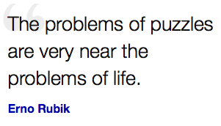
EE 360C - ALGORITHMS
Lecture 13
Greedy Algorithms 3 – Minimum Spanning Tree
Vallath Nandakumar
University of Texas at Austin

Slide 2
iClicker
You want to produce a minimum spanning tree from a connected graph with weighted edges. Which is not a greedy strategy?
Repeatedly delete the most expensive edge from G as long as it doesn’t disconnect the graph, until G is a tree.
Repeatedly add the cheapest edge in G to an initially empty graph T, keeping T acyclic, until all vertices are in T.
Repeatedly add the most expensive edge leaving a connected component, until every vertex is connected, starting with any vertex.
All the above are greedy strategies.

Slide 3
iClicker – Unique MST
Let G be a connected graph, and T₁ and T₂ be minimum spanning trees on G. T₁ = T₂
If and only if G is a tree
If and only if (G is a tree OR the edge weights are unique)
If and only if the edge weights are unique
None of the above
EE 360C

